Slide 1
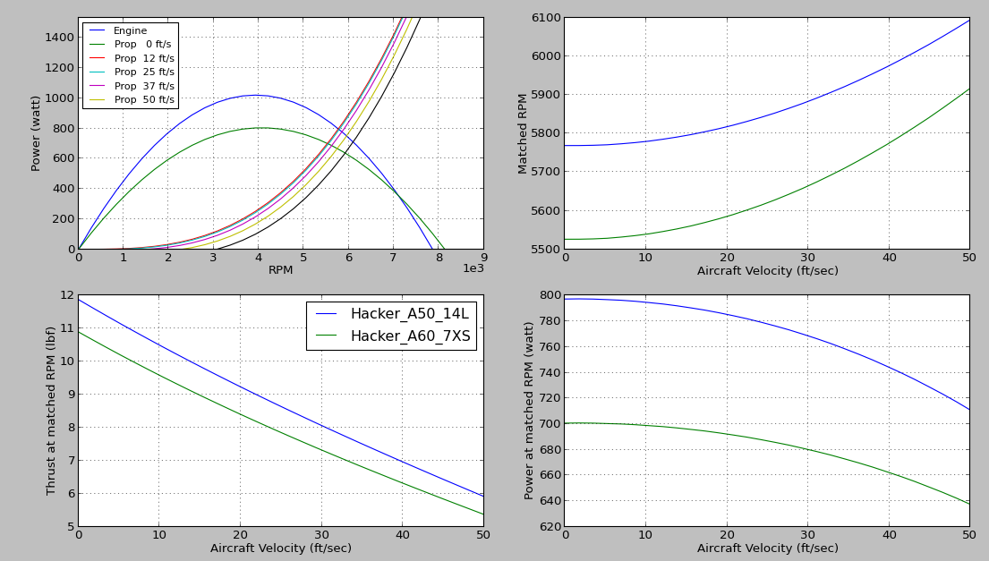

Best Prop & Motor Match
20x8 Prop - Hacker A50 14L
Static: 11.5-12lbs thrust

Slide 2
Summary Statistics
Continuous Power Draw: 940W
Static Thrust: 11.5-12lbf
Static Runtime: 4 minutes
Item | Stat
Power Draw | 940W Continuous
Static Thrust | 11.5-12lbf (15-20% increase)
Static Runtime (worst case) | 4 minutes

Slide 3
BACKUP

Slide 4

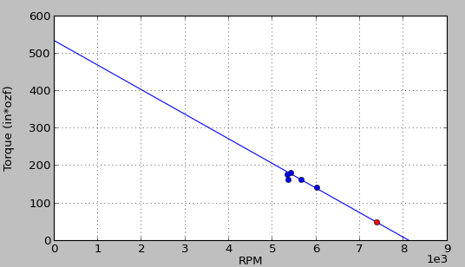
Hacker A60 7XS

Slide 5
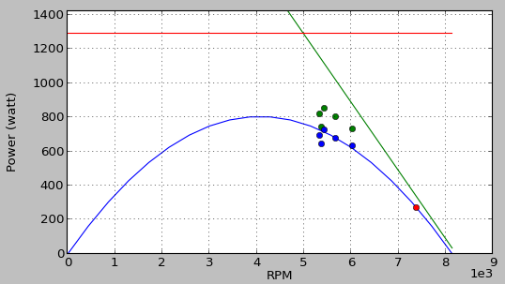
Hacker A60 7XS

Slide 6
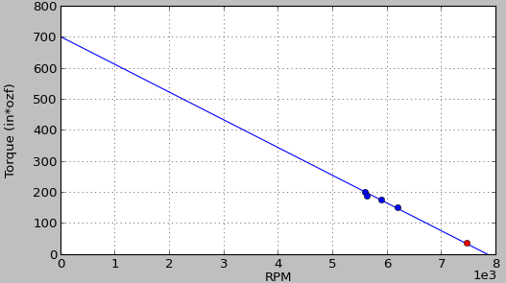
Hacker A50 14L

Slide 7
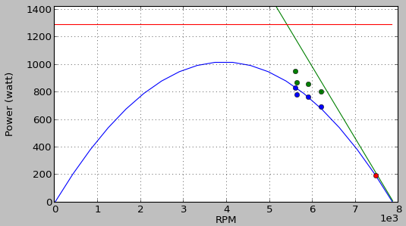
Hacker A50 14L

Slide 8
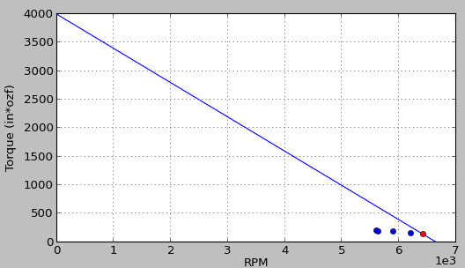
Hacker A50 14L – Pre Match

Slide 9
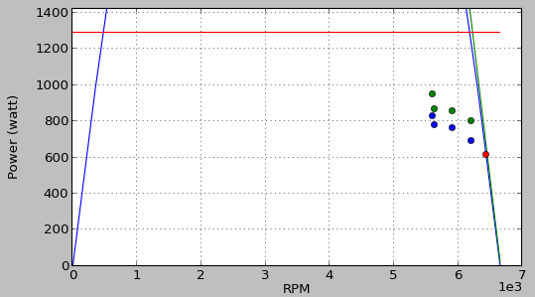
Hacker A50 14L – Pre Match

